Slide 1
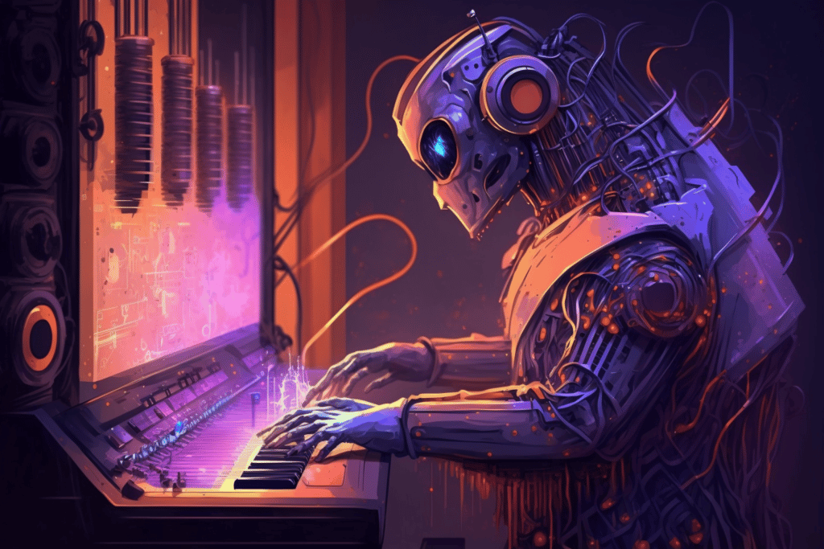
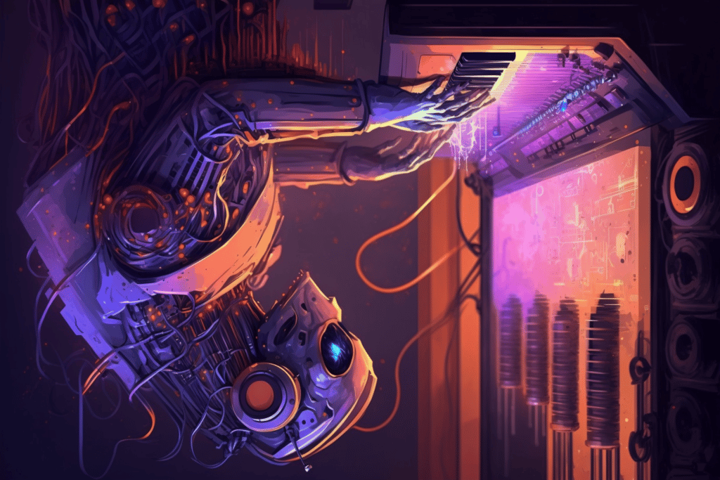
The Development and
Practice of AI Technology
for Contemporary Popular
Music Production
Team No. 28
ID: 20101477
Name: Md. Sifat Mahmud
ST name: Farah and Sania

Slide 2
INTRODUCTION
Historical Perspective
Emergence of AI Technology
Versatility of AI in Music
Complexity of AI Integration
Questions and Challenges
Focus on Contemporary Popular Music
Conclusion and Future Works

Slide 3
Music Production Use Cases
Diverse Nature of Music Production: Music production is a multifaceted process that encompasses various activities.
Three Broad Types of Music Production: AI tools can be applied in three main contexts: music composition, live performance and improvisation, and in-studio composition.
Music Composition: AI tools designed for music composition involve creating symbolic descriptions of musical works, but their applicability is limited to genres with substantial data in symbolic formats.
Live Performance and Improvisation: In this context, AI tools focus on real-time interaction and responsiveness, catering to instrumental performances and DJ sets.
In-Studio Composition: The primary focus for this paper is in-studio composition, which revolves around digital audio workstations (DAWs) where music notation, sound recording, editing, and mixing activities coexist and often overlap.

Slide 4
AI Technology for in-Studio Composition
Music production as in-studio composition
Implications for AI technology

Slide 5
Music production as in-studio composition
Historical Music Production: In the 18th and 19th centuries, music production had a linear process: composition → performance → consumption. Roles of composer and performer were distinct.
Modern Sound Recording: The sound recording studio added steps to this process, including editing, mixing, and mastering, often performed by sound engineers and overseen by producers.
Evolving Roles: The 1980s saw technology democratize access to studio tools, blurring the lines between composer, musician, sound engineer, and producer, challenging notions of art and craft.
In-Studio Composition: In-studio composition is the focus of this paper, where compositional activities are intertwined with sound editing and sound design.
Reduced Need for Music Notation: In this context, the necessity for traditional music notation diminishes. Musicians readily access sound recordings, reducing the reliance on symbolic notation.
MIDI and Symbolic Representation: While MIDI is prevalent in contemporary Popular Music (CPM) production, its use may differ.
Genre-Specific Challenges: The use of MIDI in CPM may vary based on genres, especially those with electronically designed sounds and samples.
Diverse Musical Styles: Traditional music analysis categories may not neatly apply to all musical styles, such as rap and electronic genres.

Slide 6
Implications for AI Technology
Challenges in Traditional Views: Traditional perspectives in deep learning for music generation often emphasize symbolic representations and a linear view of music production.
Awareness of Limitations: Recent efforts have recognized limitations in such assumptions, acknowledging the need for a broader view of music production, especially in contemporary art music genres.
Utility of AI Music Tools: The arguments don't question the utility of existing AI music tools, such as piano-roll-based modeling approaches. These tools have demonstrated their effectiveness in various aspects of music generation.
Designing AI Tools for In-Studio Composition: To support a wider range of in-studio composition activities, AI tools should handle various types of information, including audio. This enables a more comprehensive interaction between AI tools and the artist's digital audio workstation (DAW).
Benefits of Audio-Based AI Tools: Audio-based AI tools expose the sonic qualities that are not represented by MIDI, allowing artists to interact with AI models beyond explicit controls.
Challenges and Solutions: While audio-based AI tools pose challenges related to computational resources and long-range dependencies, recent systems like Jukebox demonstrate their feasibility.

Slide 7
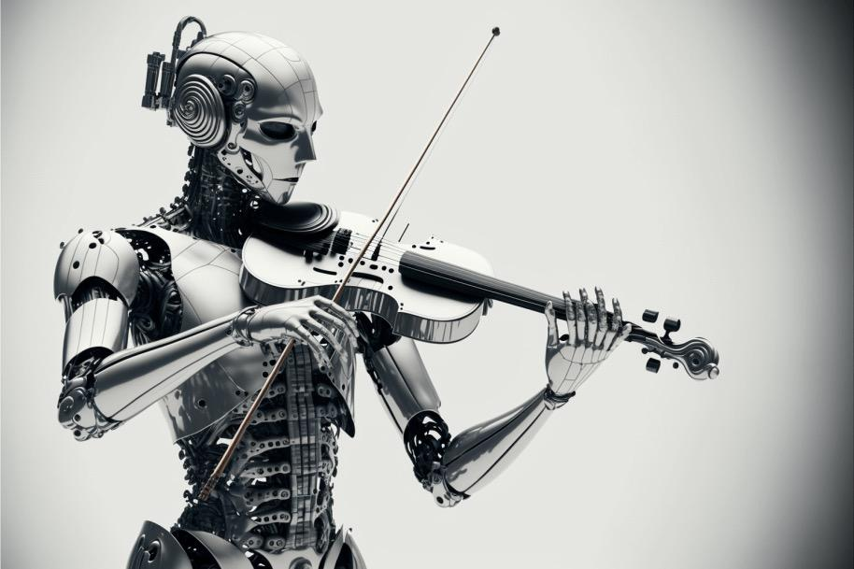
Using AI Tools in Practice
Tools used
Procedure
Results and discussion
Interaction and visualization

Slide 8
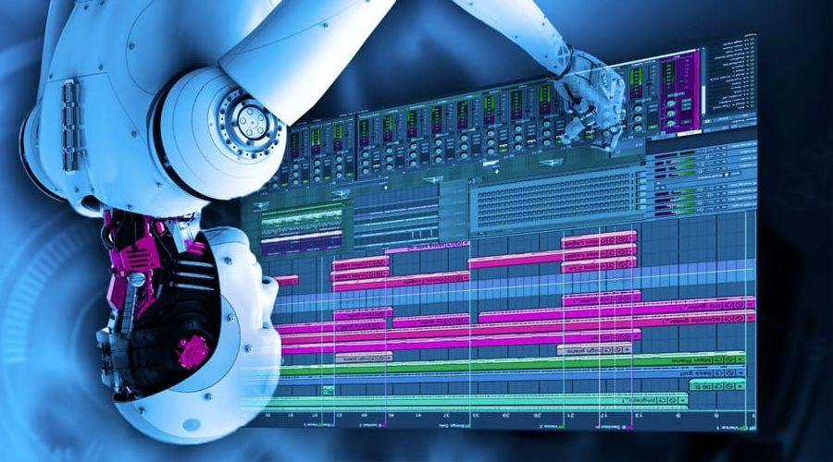
Tools Used
AI Tool Development
The AI tools provided to artists are recent developments from our research lab. These tools are generally in the form of prototypes, which can be standalone applications, VST plug-ins for digital audio workstations (DAWs), or servers accessible through a web interface.
Tool Variety
These AI tools cover various aspects of the music production process, including sound design, mixing, equalization, and the generation of melodic and rhythmic material. They are designed to work with audio representations as input data, and depending on the tool, the output can be audio, MIDI, or both.

Slide 9
Tools Used
Tool Descriptions
Notono
Planet Drums, DrumGAN, Impact Drums
DrumNet
BassNet, LeadNet
ResonanceEQ, ProfileEQ

Slide 10
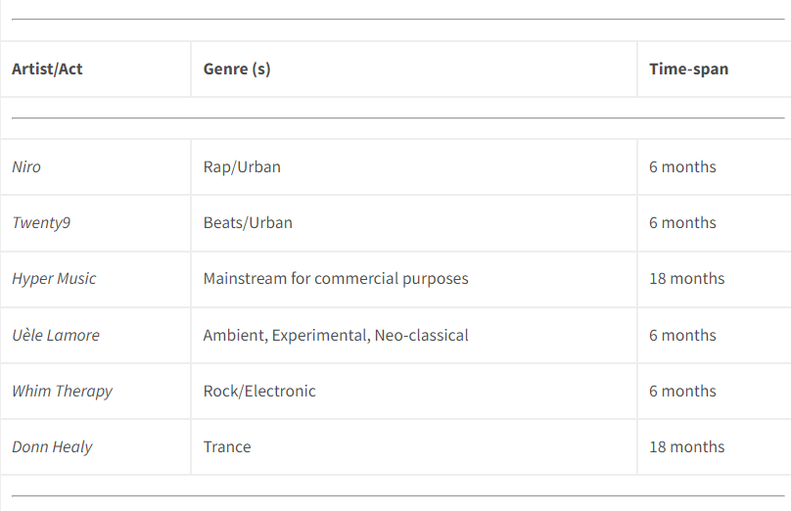
PROCEDURE
Collaboration Introduction
Tool Demonstration
Hands-On Experimentation
Feedback and Follow-Up
Tool Adaptation
Outcome Submission
Interviews
17%
Collaborating artists/acts.

Slide 11
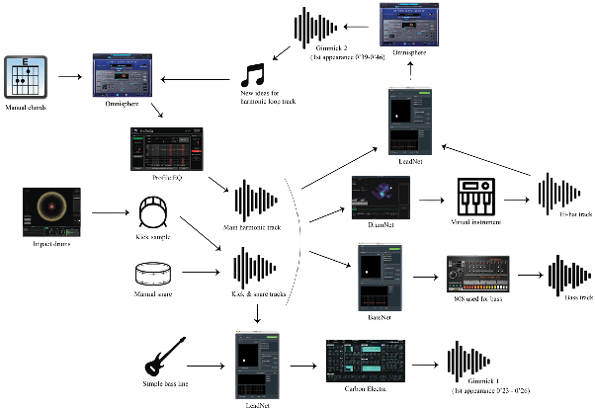
Results and discussion
Collaboration Results
Workflow Decomposition
Push and Pull Interactions
Priming Process
Exploration through Control
AI as the New Analog
Out-of-Domain Scenarios
Machine Interference
Co-Exploration
Example workflow diagram by artist duo Hyper Music. The diagram shows how various AI tool prototypes are used in the music production process.

Slide 12
Interaction and visualization
Artist Feedback: Artists often provide suggestions for improving interaction with AI tools, including convenience features and better access to latent dimensions.
Usability Enhancements: Some suggestions align with Shneiderman's recommendations for creativity-support tool design, focusing on user-friendly interfaces.
Understanding Model Behavior: In models with learned latent spaces, understanding how controls affect the output can be challenging.
Mapping Behavior: Visualizing the effects of latent space controls through a-posteriori mapping helps users navigate variations more effectively.
Appropriation of Music Software: Scurto and Bevilacqua's approach suggests using AI to support user exploration and learning of AI tool capabilities.
Interactive Feedback: Interactive feedback combined with reinforcement learning can assist users in adapting AI tools to their specific needs.
Two-Level Design: The potential for a two-level design, where the first level learns from generic criteria and the second level assists users in tailoring AI tools to their needs.

Slide 13
Lessons Learned from AI-Based Musical Research
Interdisciplinary Challenge
The creative process in music production is open-ended and exploratory, which presents a significant challenge when developing AI tools to support it. This endeavor intersects machine learning, creativity studies, and user design.
Tension with Machine Learning
There's an inherent tension between the open-ended, creative music production process and the structured nature of machine learning, which relies on quantifiable success criteria and defined problems.
Collaboration with Artists
Collaborating with artists is essential, but it's not straightforward. User needs can be hard to define and may evolve as they interact with technology.

Slide 14
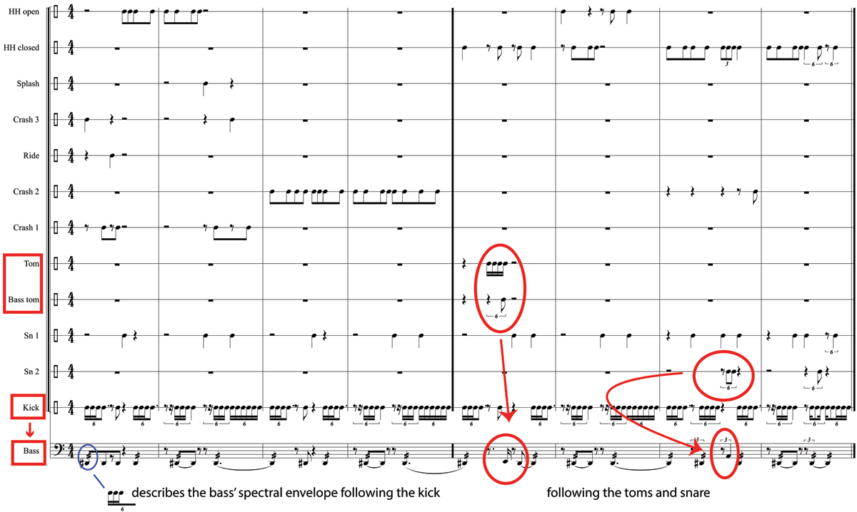
Lessons Learned from AI-Based Musical Research
Recommendations:
Work Alongside Musicians
Foster Chance and Serendipity
Focus on creative assistance, not AI with Full Autonomy
Adapt to Music and Workflows
Simplify complex tasks.
Enhance creativity and ensure recognizable contributions
Example of BassNet’s behavior when confronted with out-of-domain input. BassNet (bottom-most track) adjusts its output’s spectral envelope to the kick’s attacks, and reacts to the tuning of the percussion.

Slide 15
CONCLUSIONS AND FUTURE WORK
AI in CPM: We've explored AI in Contemporary Popular Music (CPM) production.
In-Studio Process: We identified a gap between AI research and the real-world in-studio music-making process.
Audio-Based AI: Audio-based AI tools better suit artists' creative workflows.
Collaborative Insights: Artist collaborations emphasized practicality, control, and visualizations.
Future Work:
- Develop a systematic assessment methodology.
- Define specific use-cases in the in-studio context

Slide 16
Thank you!

